Slide 1
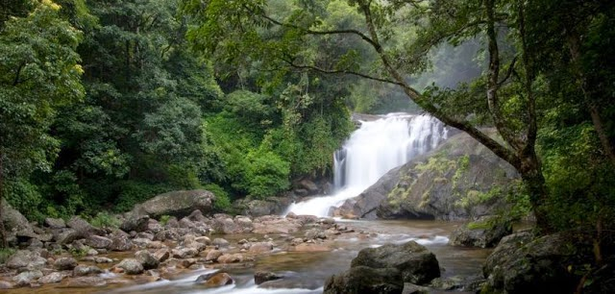
Geography Curriculum
XI,XII

Slide 2
SCOPE AND OBJECTIVES
Geography as a Discipline Explores:
the relationship between human and its environment.
facts and cause relationship of physical and human features at different domains.
the distribution pattern of physical and human resources.
various methodologies like field survey, data analysis and interpretation through systematic and regional approaches.

Slide 3
OBJECTIVES
THE COURSE IN GEOGRAPHY WILL HELP LEARNERS:
To familiarize themselves with the terminologies & key concepts.
To analyze the inter-relationship between physical and human environments and their impact.
To deal with the issues related to environment, socio-economic-political concerns at local or global level.
To develop Geographical skills to collect, process and analyze data for preparing report, maps , graphs and to give inference.

Slide 4
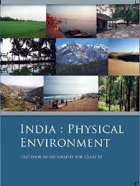
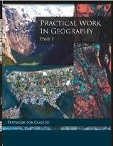
Class XI Geography
Part- 1
Part- 2
Practical

Slide 5
PART I FUNDAMENTALS OF PHYSICAL GEOGRAPHY
UNIT I: GEOGRAPHY AS A
DISCIPLINE
UNIT II: THE EARTH
UNIT III: LANDFORMS
UNIT IV: CLIMATE
UNITV:WATER (OCEANS)
UNIT VI: LIFE ON THE EARTH
25+5=30 MARKS
5 MARKS
MAPS
&
DIAGRAMS

Slide 6
PART II INDIA: PHYSICAL ENVIRONMENT
UNIT I: INTRODUCTION
UNIT II:PHYSIOGRAPHY
UNIT III: CLIMATE,
VEGETATION, SOILS
UNIT IV: NATURAL HAZARDS AND
DISASTERS: CAUSES,
CONSEQUENCES AND MANAGEMENT
25+5=30 MARKS
5 MARKS
MAPS
&
DIAGRAMS

Slide 7
PRACTICAL WORK IN GEOGRAPHY
UNIT I: FUNDAMENTALS OF MAPS
(map scales, latitudes, longitudes and map projections)
UNIT II: TOPOGRAPHIC AND WEATHER MAPS
(contour cross sections, topographic maps and weather maps interpretation, satellite imageries)
UNIT III: PRACTICAL RECORD BOOK AND VIVAVOCE
10
15
05
30

Slide 8
Marks Distribution
30
Part -1
30
Part-2
10
OTBA
70
Total(Theory)
30
Practical

Slide 9
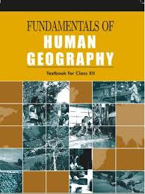
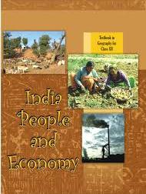
Class XII Geography
Part- 1
Part- 2
Practical

Slide 10
About the Course
Human Geography deals about variety of human activities on the surface of the land/earth or the interaction between Land and Man.
Book – 1 deals about the human activities with reference to the World.
Book -2 deals about human activities with reference to India
Book -3 deals about statistical data and representing data through various diagrams.

Slide 11
Book -1 Fundamentals of Human Geography
Chapters:-
1) Human geography –Nature and Scope
2) The World population-Distribution, Density and Growth
3) Population composition
4) Human Development
5) Primary activities

Slide 12
6) Secondary activities
7) Tertiary and quaternary activities
8) Transport and communication
9)International Trade
10) Human Settlements

Slide 13
BOOK-2
INDIA-PEOPLE AND ECONOMY
Chapters :-
1) Population-Distribution, Density , Growth and Composition
2) Migration-Types, Causes and Consequences
3) Human Development
4) Human Settlements
5) Land resources and Agriculture
6)Water resources

Slide 14
7) Mineral and Energy resources
8) Manufacturing Industries
9) Planning and Sustainable development in Indian context
10) Transport and Communication
11) International trade
12) Geographical Perspective on selected issues and problems

Slide 15
BOOK-3 PRACTICAL WORK IN GEOGRAPHY
Chapters:-
1) Data- Its source and Compilation
20 Data Processing
3) Graphical Representation of Data
4)Use of Computer in Data processing and Mapping
5) Field Surveys
6) Spatial Information Technology

Slide 16
Marks Distribution
35
Theory (Book-1)
35
Theory (Book-2)
20
Practical( General)
10
Field Survey
70
30

Slide 17
Field Trips

Slide 18
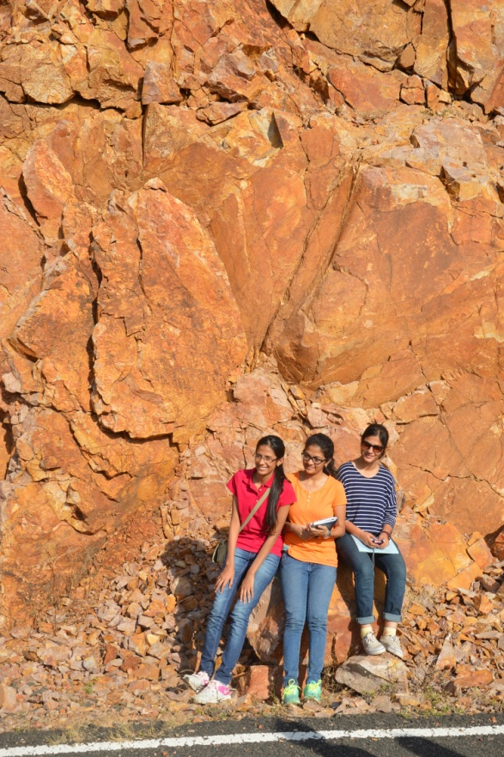
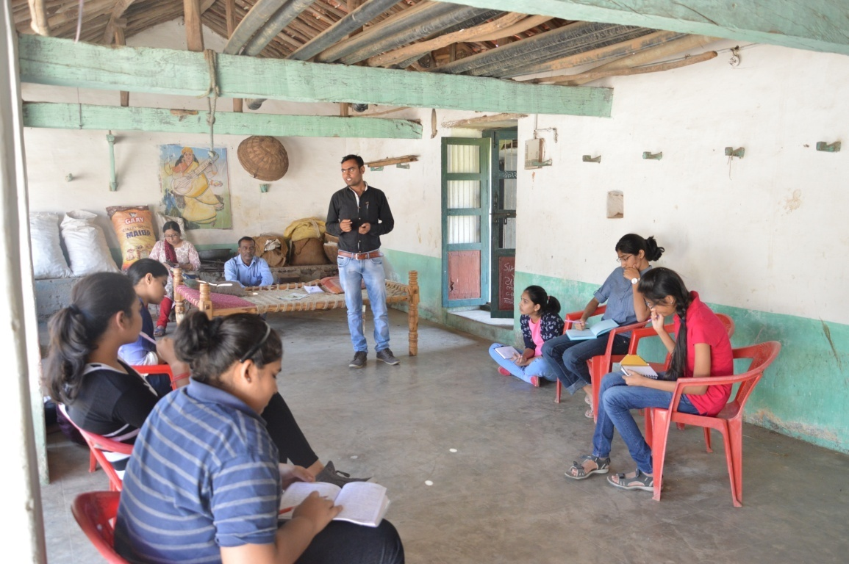
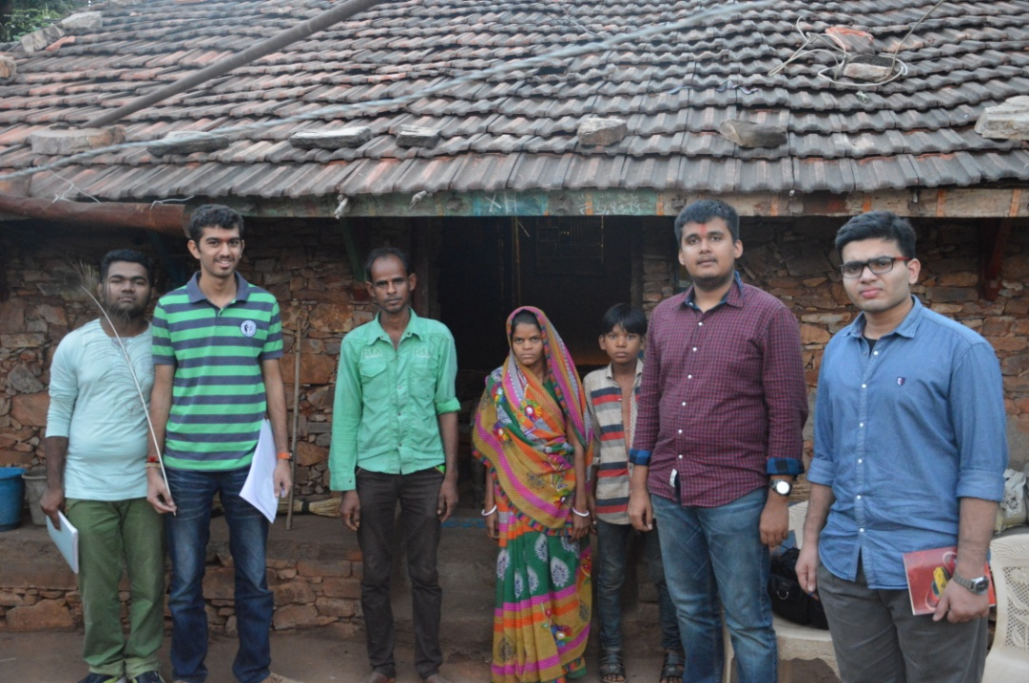

Slide 19
Thank You
&
Best Wishes
Mrs. Samita Das Gupta
Mr.S.Gopalakrishnan

